Slide 1
Factory Method
Design Pattern
Chris Drew 16th July 2014

Slide 2
Outline
Intro to PizzaStore with simple (static) factory
Live demo introducing factory method pattern
Look at the definition of factory method pattern
Applicability
Pros and cons
Differences vs Abstract Factory pattern

Slide 3
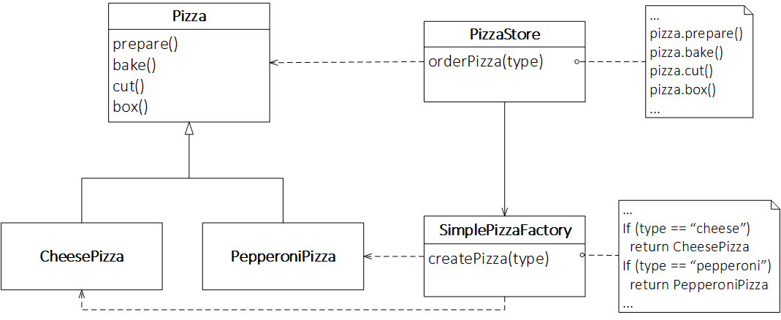
PizzaStore
Notes:
SimplePizzaFactory could have many clients, e.g PizzaStoreMenu
createPizza could be a static method or even a non-member function

Slide 4
Demo

Slide 5
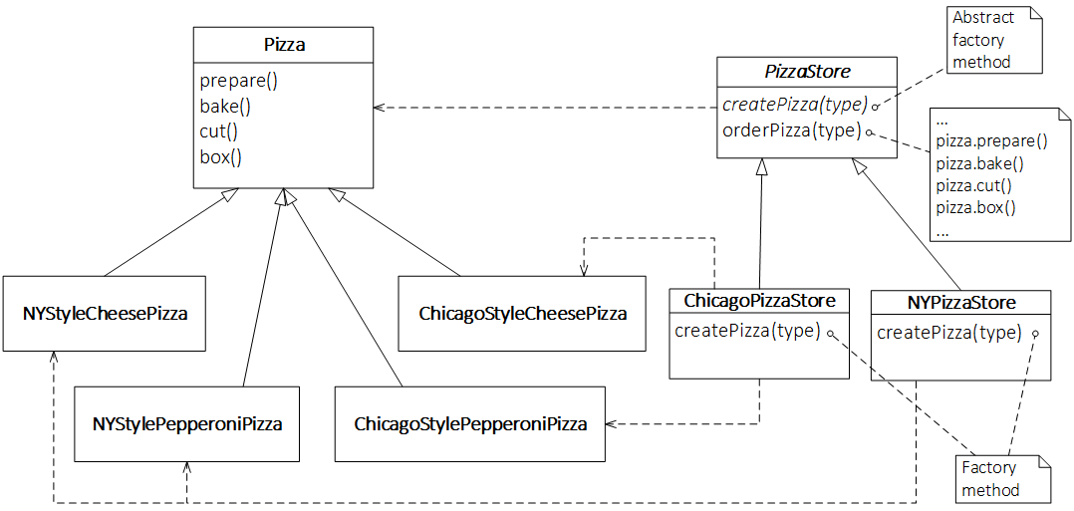
Factory Method Pattern - Example

Slide 6
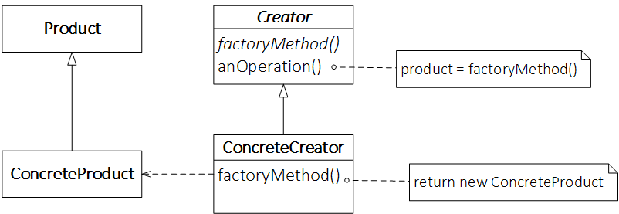
Factory Method Pattern - Defined
Defines an interface for creating an object, but lets subclasses decide which class to instantiate. Factory Method lets a class defer instantiation to subclasses.

Slide 7
Applicability
A class can’t anticipate the class of objects it must create.
A class wants its subclasses to specify the objects it creates.

Slide 8
Consequences
Provides hooks for subclasses
Connects parallel class hierarchies
Notes:
ConcreteCreator’s could be used in more than one class, e.g a parallel class hierarchy to the creator heirachy, that want to use the Products

Slide 9
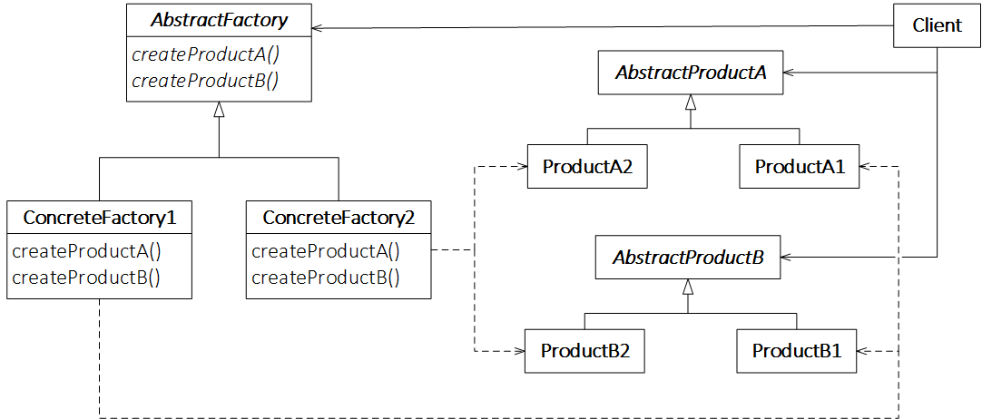
Reminder Abstract Factory

Slide 10
Differences vs Abstract Factory Pattern
Abstract Factory creates a family of products
Pattern refers to only one method rather than whole object
Class vs Object scope?
Notes:
In Factory Method Pattern, the rest of the Creator class can do whatever it likes but in Abstract Factory pattern the AbstractFactory’s whole job is to create products.
People refer to Abstract Factory working through composition but Factory Method working through inheritance. I don’t buy it.

Slide 11
References & Links
Eric and Elisabeth Freeman, Head First Design Patterns, 2004
Gamma et al, Design Patterns, 1994
https://github.com/crsdrw/patterns/tree/factory_method

